Slide 1
Welcome to Alberta

Slide 2
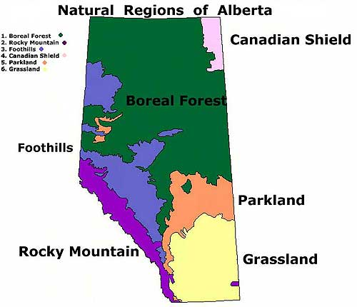
Alberta’s Diversity
Alberta is a diverse province.
Diverse means that there are lots of different thing in it.
Today we will learn about the different parts of Alberta.

Slide 3
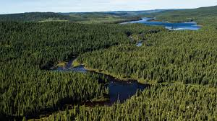
Boreal Forest
Alberta’s biggest region is the Boreal Forest.
It covers the Northern part of the province.
It is heavily forested and has more rain and less heat than the rest of the province.
Back to map

Slide 4
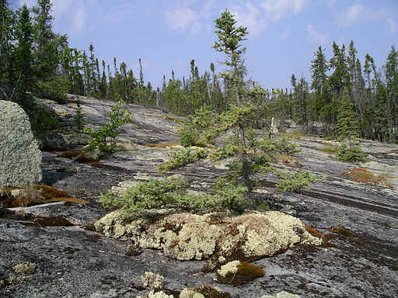
Canadian Shield
The Canadian Shield is mostly in the territories, but a small part is in Alberta.
It is very rocky and does not have very good soil for growing things, so forests are spread out.
Back to Map

Slide 5
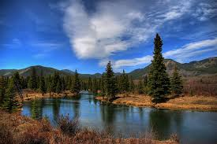
Foothills
The foothills lead up to the mountains. They are big, rolling hills.
They have many forests, streams, and rivers that are good for hiking and camping. They are also home to many animals.
Back to Map

Slide 6
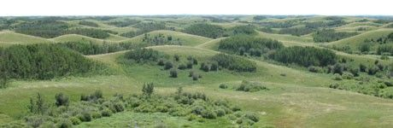
Parkland
The Parkland has trees, streams, and lot of good farming. Edmonton is in the Parkland.
Because of people building cities and big farms, only 5% of the Parkland is in its natural state.
Back to Map

Slide 7
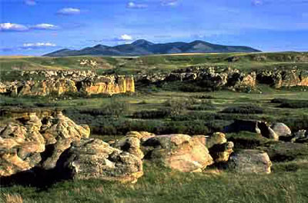
Grasslands
The Grasslands has less moisture (water/rain) than the rest of the province. It is rocky and not very forested, but beautiful in its own way.
Drumheller is located in the Grasslands.

Slide 8
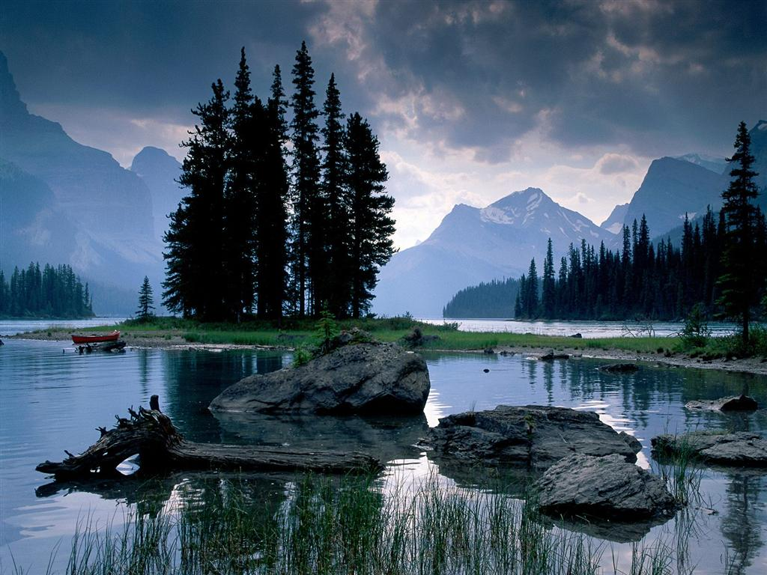
Rocky Mountains
The Rocky Mountains are home to many animals and vegetation.
In Alberta, we have four national parks in the Rockies, protecting some of the beauty and habitat.

Slide 9
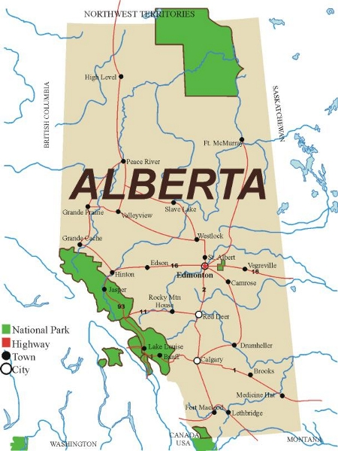

Slide 10
Discussion/Writing
If you could live anywhere in Alberta, where would you live? Why?
Which region do you think is the best part of Alberta? Why?

